Slide 1

Deep Learning Approaches to Profiling & Predicting Organizational Threats – NEXTGEN SOC
24-25J-075
IT21298608 – D.H. Senevirathne (L)
IT21380396 – M.F.F. Ashra
IT21058196 – K.P.A.T. Gunawardhana
IT21226496 – W.M.M. Gunasekara

Slide 2
Content of the Presentation
1. Introduction to the overall project
2. Research Problem
3. Research Objectives
4. Overall System Diagram
5. Organizational Threat profiling with network traffic analyze
6. Organizational Threat profiling with Endpoint Data
7. Organizational Threat profiling with Human behavior analysis
8. Organizational Threat profiling with Physical Security Systems

Slide 3
Introduction to the overall project
Evolving cybersecurity landscape with increasingly sophisticated threats.
Need for NextGen SOCs to handle volume and complexity of attacks.
Potential of deep learning to analyze vast, heterogeneous data.
Research focus on profiling and predicting organizational threats.
Integration of network traffic, endpoint logs, physical security systems, and human behavior data.
Develop modern SOCs for improved threat detection and response.[1]

Slide 4
Research Problem
Organizations face increasingly complex and sophisticated cyber threats that traditional Security Operations Centers (SOCs) struggle to manage. NextGen SOCs must utilize deep learning to enhance threat profiling and prediction. However, integrating diverse data sources, adapting to evolving threats, ensuring scalability, and maintaining ethical standards present significant challenges. This research aims to develop advanced deep learning models to accurately profile and predict organizational threats, addressing these critical challenges to improve organizational security.

Slide 5
Research Objectives
Main Objective:
To develop and validate adaptive deep learning models for comprehensive threat profiling in NextGen Security Operations Centers (SOCs), enhancing detection and response capabilities across diverse organizational environments.
Sub-Objectives:
Threat Profiling with Endpoint Data
Threat Profiling with Physical Security Systems
Threat Profiling through Human Behavior Analysis
Threat Profiling with Network Traffic Analysis

Slide 6
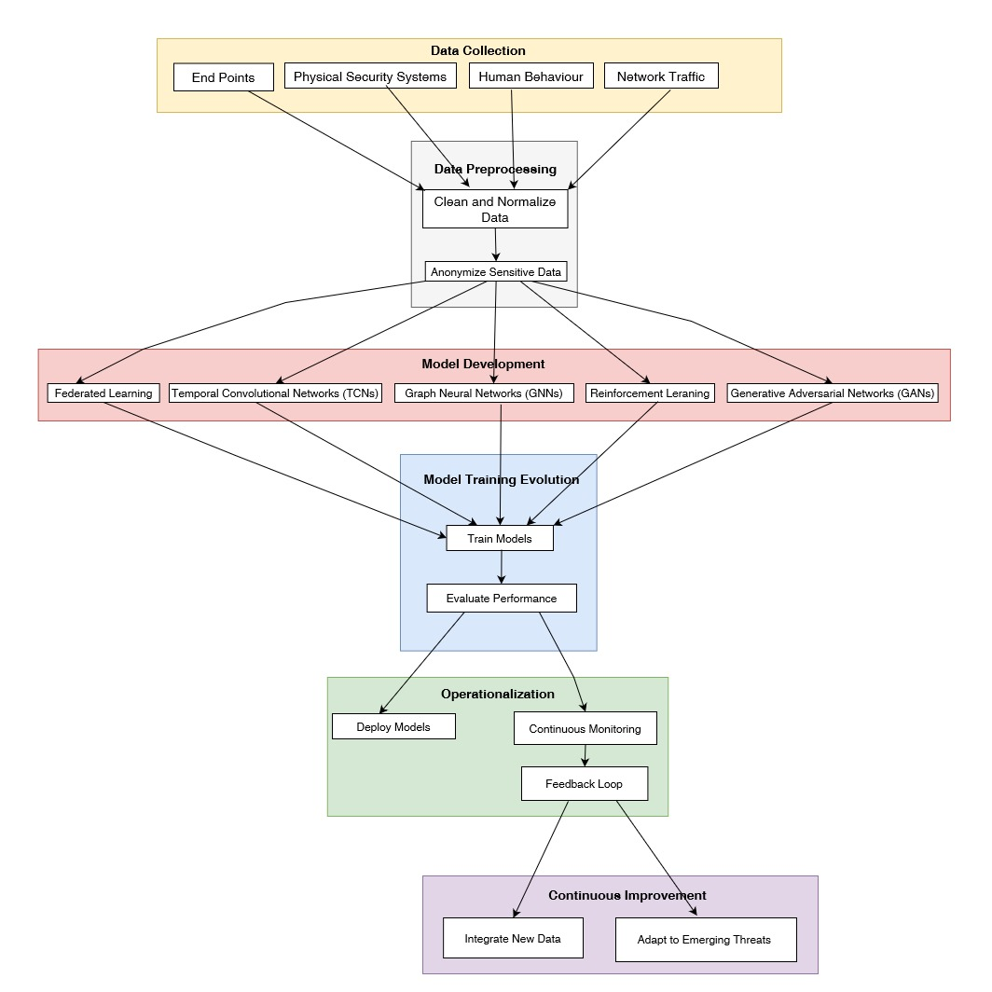
Overall System Diagram

Slide 7

Organizational Threat profiling with network traffic analyze IT21226496 | W.M.M. Gunasekara specialize in cybersecurity

Slide 8
Background & Research Gap
Background
Increasing complexity and volume of network traffic challenge traditional security measures.
Sophisticated cyber threats utilize advanced techniques to evade detection.
Difficulties in monitoring and analyzing vast amounts of network data in real-time.
Existing methods struggle with adapting to new and evolving threats.
Presence of encrypted traffic complicates threat profiling and analysis.
IT21226496 | Gunasekara W.M.M. | 24-25J-075

Slide 9
Research Gap
Background & Research Gap Cont.
Features/Research Project | Automated Intrusion Detection and Prevention Model [2] | Real-Time Network Security Monitoring [3] | Anomaly-Based Intrusion Detection[4] | Scalable Network Security Solutions[5] | My Approach
Real-time Threat Detection | X | X |  |  | X
Anomaly Detection |  |  | X |  | X
Scalability |  |  |  | X | X
Adaptive Learning | x |  |  |  | X
IT21226496 | Gunasekara W.M.M. | 24-25J-075

Slide 10
Research Problem
Real-time network traffic analysis for threat predictions complex due to the dynamic nature of network environments and the evolving tactics of cyber attackers. Traditional methods often fail to adapt quickly to new attack vectors. Developing real-time analytics using Graph Neural Networks (GNNs) and Deep Reinforcement Learning, combined with Generative Adversarial Networks (GANs), can improve threat prediction and adaptation. However, effectively collecting, processing, and analyzing vast amounts of network traffic data in real-time to identify and respond to emerging threat level remains a significant challenge.
IT21226496 | Gunasekara W.M.M. | 24-25J-075

Slide 11
Specific and sub objectives
Specific Objective
Develop advanced deep learning models to accurately profile and predict organizational threats through network traffic analysis.
Sub-Objectives
Gather real-time network traffic data and Preprocess data to handle noise and ensure consistency.
Design Graph Neural Networks (GNNs) for capturing complex network patterns.
Design Generative Adversarial Networks (GANs) for Train models on historical and simulated network traffic data.
Implement Reinforcement Learning algorithms to adapt to dynamic threats.
IT21226496 | Gunasekara W.M.M. | 24-25J-075

Slide 12
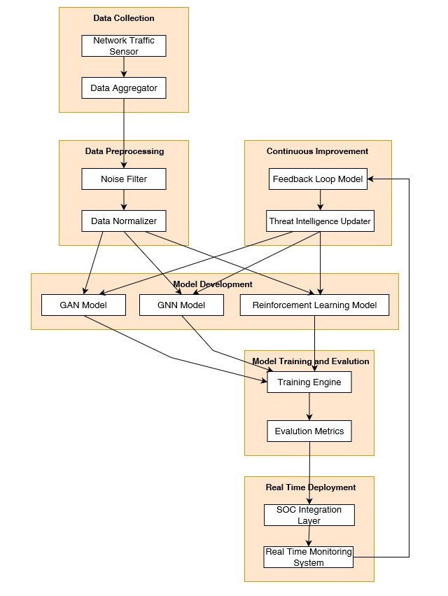
Methodology
IT21226496 | Gunasekara W.M.M | 24-25J-075

Slide 13

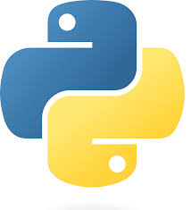

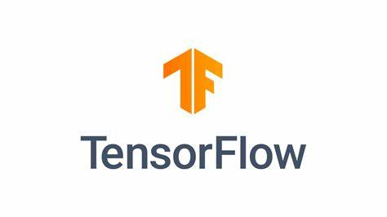
Technologies and Tools to be used
Technologies
TensorFlow
PyCharm
DGL (Deep Graph Library)
Scikit-learn
Flask
Tools
Wireshark
Kaggle
Python
MLflow
Keras
MongoDB
IT21226496 | Gunasekara W.M.M. | 24-25J-075

Slide 14
Study Requirement Specification
System Requirements
Hardware Requirements
High-performance servers with multi-core processors (e.g., Intel Xeon, AMD EPYC)
Minimum 64 GB RAM
High-speed network interface cards (10 Gbps or higher)
SSD storage for fast data access and processing
GPU support (e.g., NVIDIA Tesla, RTX series) for deep learning model training and inference
Network Requirements
Reliable and high-bandwidth network infrastructure
Secure network connections for data transmission
Redundant network paths for high availability and fault tolerance
Security Requirements
Secure data storage and encryption mechanisms
IT21226496 | Gunasekara W.M.M. | 24-25J-075

Slide 15
Study Requirement Specification Cont.
Personal Requirements
1. Skills and Expertise
Expertise in cybersecurity and network security
Proficiency in machine learning and deep learning techniques
Experience with network traffic analysis tools (e.g., Wireshark, Suricata)Knowledge of programming languages (e.g., Python)Familiarity with data preprocessing and analysis
2. Roles and Responsibilities
Cybersecurity Analysts: Monitor and analyze network traffic, identify threats, and respond to security incidents.
Data Scientists: Develop and train deep learning models, perform data preprocessing, and evaluate model performance.
System Administrators: Manage and maintain the infrastructure, ensure high availability, and implement security measures.
Software Developers: Develop and integrate software components, ensure compatibility with existing systems, and implement updates.
IT21226496 | Gunasekara W.M.M. | 24-25J-075

Slide 16
Study Requirement Specification Cont.
Software Requirements
1. Operating System
Windows operating systems
2. Development and Analysis Tools
Python with libraries such as TensorFlow, PyTorch, Scikit-learn, DGL
Network analysis tools like Wireshark and Suricata
Data processing tools like Apache Kafka, Logstash
3.Database Management
NoSQL databases (e.g., MongoDB) for storing and querying large volumes of network traffic data
4. Monitoring and Logging
Tools like Prometheus and Grafana for real-time monitoring and visualization
IT21226496 | Gunasekara W.M.M. | 24-25J-075

Slide 17
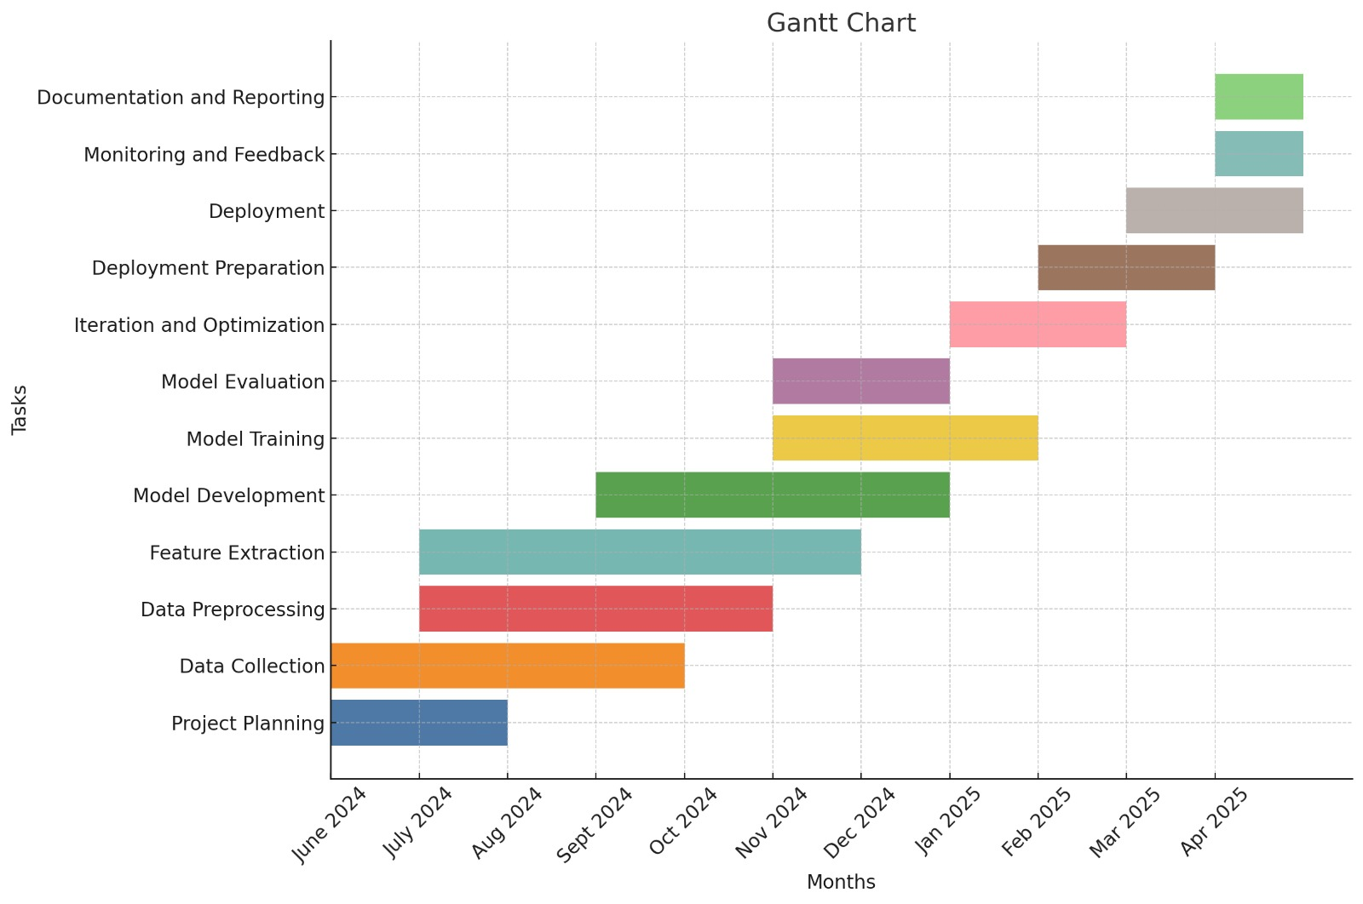
Gantt Chart
IT21226496 | Gunasekara W.M.M. | 24-25J-075

Slide 18
Commercialization
Market Demand
Competitive Advantage
Scalability
Integration Capability
Subscription-Based Model
Regulatory Compliance
IT21226496 | Gunasekara W.M.M. | 24-25J-075

Slide 19
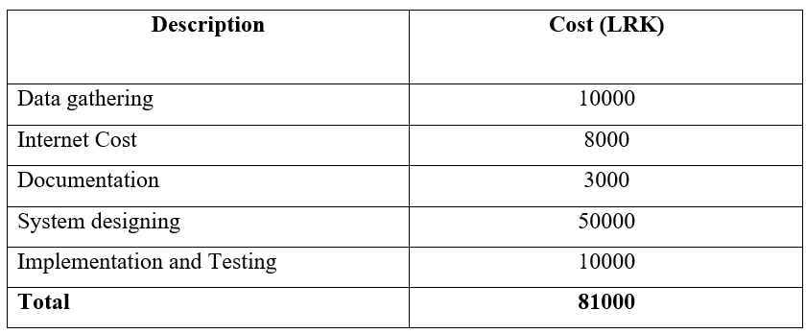
Budget
IT21226496 | Gunasekara W.M.M. | 24-25J-075

Slide 20
References
[1] Manoharan and M. Sarker, “REVOLUTIONIZING CYBERSECURITY: UNLEASHING THE POWER OF ARTIFICIAL INTELLIGENCE AND MACHINE LEARNING FOR NEXT- GENERATION THREAT DETECTION,” International Research Journal of Modernization in Engineering Technology and Science, vol. 4, pp. 2151–2164, Apr. 2022
[2] “An Automated Intrusion Detection and Prevention Model for Enhanced Network Security and Threat Assessment", 2023.https://www.ijcna.org/abstract.php?id=3038 (accessed Aug. 04, 2024).
[3]"Real-Time Monitoring of Network Devices: Its Effectiveness in Enhancing Network Security
https://www.researchgate.net/publication/349817804_RealTime_Monitoring_of_Network_Devices_Its_Effectiveness_in_Enhancing_Network_Security (accessed Aug. 04, 2024)
[4] "Anomaly-Based Intrusion Detection Using Machine Learning: An Ensemble Approach", https://www.researchgate.net/publication/364437088_Anomaly-Based_Intrusion_Detection_Using_Machine_Learning_An_Ensemble_Approach (accessed Aug. 04, 2024)
[5]"Networks Security models Scalability Analysis" https://www.researchgate.net/publication/351584115_Networks_Security_models_Scalability_Analysis (accessed Aug. 04, 2024)
‌
IT21226496 | Gunasekara W.M.M. | 24-25J-075

Slide 21

Organizational Threat profiling with Endpoint Data IT21380396 | M.F.F. ASHRA specialize in cybersecurity

Slide 22
Background & Research Gap
Background
Smart devices (laptops, smartphones etc.) store valuable information and are prime targets for data breakers.
Traditional security methods are ineffective against increasingly sophisticated data breakers.
New protection methods are needed to secure devices and data.
Federated Learning (FL) allows collaborative model training without sharing raw data, ensuring data privacy and security.
Self-Supervised Learning (SSL) leverages unlabeled data for training, reducing the need for costly labeled data and preparing models to address new threats.
FL and SSL combined can protect endpoint devices from emerging cyber threats while maintaining data privacy.
IT21380396 | Ashra M.F.F. | 24-25J-075

Slide 23
Research Gap
Background & Research Gap cont.
Features | Current Endpoint Security Solutions [1] | Adaptive Malware Detection Models [2] | Real-Time Endpoint Monitoring [3] | Privacy-preserving Endpoint Analysis [4] | My Approach
1. Real- time threat detection | X |  | X |  | X
2. Adaptive Learning |  | X |  |  | X
3. Scalability |  |  |  | X | X
4. Data Privacy Preservation |  |  |  | X | X
5. Integration with Existing Systems | X |  |  |  | X

Slide 24
Research Problem
Detecting threats from endpoint data is challenging due to the need for adaptive models that can handle evolving threats and software updates while preserving privacy. Traditional methods struggle with data sensitivity and require extensive labeled data. Developing adaptive neural networks using federated and self-supervised learning, combined with few-shot and transfer learning methods, can enhance threat detection. However, effectively integrating and anonymizing diverse endpoint data, such as system logs and user interactions, while ensuring model generalization and privacy, remains a significant challenge.
IT21380396 | Ashra M.F.F. | 24-25J-075

Slide 25
Main Objective
Prove the effectiveness of adaptive deep learning models using FL and SSL to detect and prevent new and complex malware attacks while maintaining data privacy and sensitivity.
Specific and sub objectives
Sub-Objectives:
Enable multiple devices (smartphones, laptops) to train a common model without sharing raw data.
Implement a master server for coordinating the training process.
Use secure messaging for model updates and handle data variability from different devices.
Generate pseudo-labels for continuous learning, reducing dependency on labeled datasets.
Test model performance with real-time data streams and large datasets in real-world environments.
Use self-administered questionnaires to collect healthcare professionals' views on model implementation in their practice.
Ensure models meet the requirements and preferences of the target audience for endpoint protection.
IT21380396 | Ashra M.F.F. | 24-25J-075

Slide 26
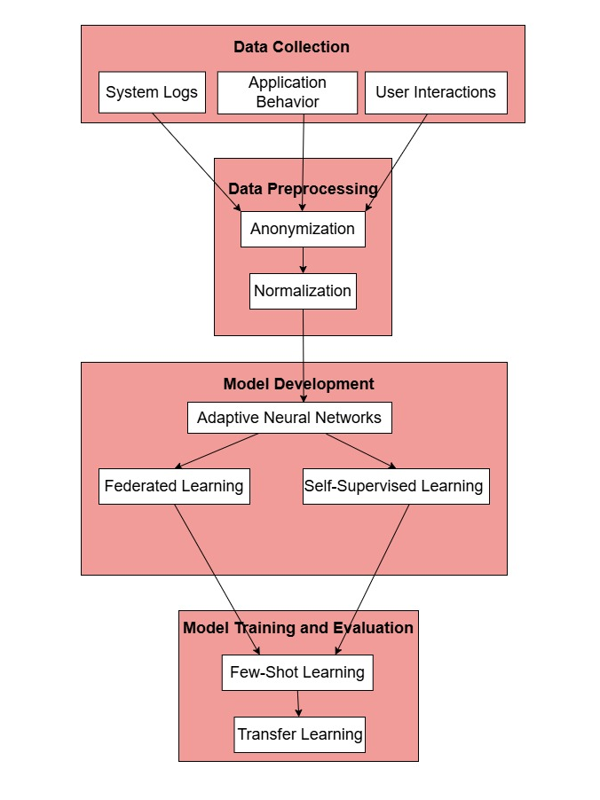
Methodology
IT21380396 | Ashra M.F.F. | 24-25J-075

Slide 27
Technologies and Tools to be used
Technologies
TensorFlow
PyCharm
Scikit-learn
Flask
Tools
Kaggle
Python
MLflow
Keras
MongoDB
IT21380396 | Ashra M.F.F. | 24-25J-075

Slide 28
Study Requirement Specification
System Requirements
Hardware Requirements
High-performance servers with multi-core processors (e.g., Intel Xeon, AMD EPYC)
Minimum 64 GB RAM
High-speed network interface cards (10 Gbps or higher)
SSD storage for fast data access and processing
GPU support (e.g., NVIDIA Tesla, RTX series) for deep learning model training and inference
Network Requirements
Reliable and high-bandwidth network infrastructure
Secure network connections for data transmission
Redundant network paths for high availability and fault tolerance
Security Requirements
Regular security audits and vulnerability assessments
Advanced log classification tools for real-time analysis and threat detection
IT21380396 | Ashra M.F.F. | 24-25J-075

Slide 29
Study Requirement Specification Cont.
Personal Requirements
1. Skills and Expertise
Expertise in cybersecurity and endpoint security
Proficiency in machine learning and deep learning techniques
Experience with endpoint monitoring tools and network traffic analysis (e.g., Wireshark, Suricata)
Knowledge of programming languages (e.g., Python)
Familiarity with data preprocessing and analysis
2. Roles and Responsibilities
Cybersecurity Analysts: Monitor and analyze endpoint data, identify threats, and respond to security incidents.
Data Scientists: Develop and train deep learning models using endpoint data, perform data preprocessing, and evaluate model performance.
System Administrators: Manage and maintain the infrastructure, ensure high availability, and implement security measures for endpoints.
Software Developers: Develop and integrate software components for endpoint security, ensure compatibility with existing systems, and implement updates.
IT21380396 | Ashra M.F.F. | 24-25J-075

Slide 30
Study Requirement Specification Cont.
Software Requirements
1. Operating System
Windows for endpoint devices
2. Development and Analysis Tools
Python with Libraries: Use Python for developing and training machine learning models, with libraries such as TensorFlow and PyTorch for deep learning, and Scikit-learn for additional machine learning functionalities.
Federated Learning Platforms: OpenFL, TensorFlow Federated (TFF), or PySyft for implementing federated learning architectures.
3.Database Management
SQL and NoSQL databases (e.g., MongoDB) for storing and querying large volumes of structured and unstructured endpoint data.
4. Monitoring and Logging
Tools like Prometheus and Grafana for real-time monitoring and visualization of system performance and model metrics.
IT21380396 | Ashra M.F.F. | 24-25J-075

Slide 31
Gantt Chart
IT21380396 | Ashra M.F.F. | 24-25J-075

Slide 32
Commercialization
Market Demand
Competitive Advantage
Scalability
Integration Capability
Subscription-Based Model
Regulatory Compliance
IT21380396 | Ashra M.F.F. | 24-25J-075

Slide 33
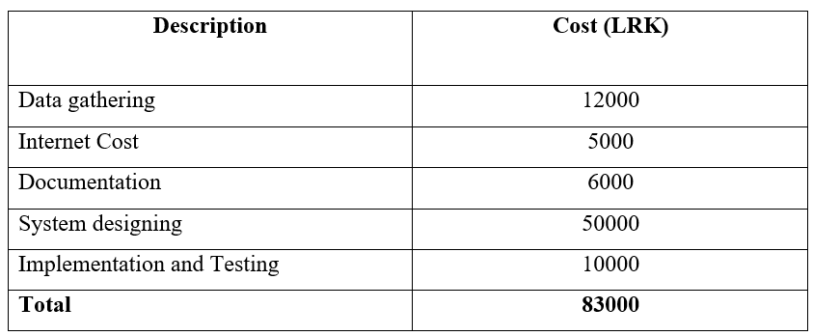
Budget
IT21380396 | Ashra M.F.F. | 24-25J-075

Slide 34
References
[1] “The Top 4 Challenges of Implementing Threat Detection and Response: Why MDR Services Make a Difference,” insights.integrity360.com. https://insights.integrity360.com/the-top-4-challenges-of-implementing-threat-detection-and-response-why-mdr-services-make-a-difference
[2] “Adapt Threat Modeling to New Challenges,” Salesforce.com, 2023. https://trailhead.salesforce.com/content/learn/modules/threat-modeling-for-threat-hunters/adapt-threat-modeling-to-new-challenges (accessed Aug. 05, 2024).
‌
[3] M. Fluhler, “Effectively Handling Large Datasets,” blog.dataiku.com, 2023. https://blog.dataiku.com/effectively-handling-large-datasets
[4] M. Adams, “Security Models Demystified: Exploring Different Security Models,” Businesstechweekly.com, Apr. 12, 2022. https://www.businesstechweekly.com/cybersecurity/application-security/security-models/
‌
IT21380396 | Ashra M.F.F. | 24-25J-075

Slide 35

Organizational Threat profiling with Human behavior analysis IT21298608|SeneVIRATHNA D.H. specialize in cybersecurity

Slide 36
Background & Research Gap
Background
Individuals within organizations are misusing access to sensitive information.
Traditional security methods often fail to detect these internal threats effectively.
Deep Learning provides advanced capabilities for detecting threats.
Balancing accurate threat detection with privacy and ethics is difficult.
Deep Learning models often face issues with either privacy violations or inadequate threat detection.
IT21298608 | Senevirathna D.H. | 24-25J-075

Slide 37
Background & Research Gap Cont.
Research Gap
Features | Traditional Rule Based System[1] | Limited Behavioral data Integration [2] | Basic machine Learning Models[3] | Limited real time Capabilities[4] | My Approach
Privacy – Preserving Techniques |  |  |  |  | X
Behavioral Pattern Analysis | X | X | X |  | X
Real – Time Analysis |  |  | X | X | X
Adaptability to New Threats |  |  |  |  | X
IT21298608 | Senevirathna D.H. | 24-25J-075

Slide 38
Research Problem
Detecting insider threats is challenging due to the complexity and sensitivity of analyzing human behavior data. Traditional methods are inadequate for identifying subtle threat patterns while preserving privacy. Developing privacy-preserving deep learning models using anonymized behavioral data, differential privacy, and Graph Neural Networks (GNNs) can enhance threat detection. However, ensuring compliance with workplace laws, ethical standards, and data protection regulations remains a significant challenge.
IT21298608 |Senevirathna D.H. | 24-25J-075

Slide 39
Specific and sub objectives
Specific Objective
Develop an advanced human behavior analysis system using deep learning and privacy-preserving techniques to improve threat profiling and detection within organizations.
Sub-Objectives
Collect and preprocess privacy-preserved behavioral data.
Design and train Graph Neural Networks (GNNs) to analyze complex employee interaction patterns.
Integrate differential privacy techniques to protect personal information during model training.
Deploy and continuously improve the model for ongoing threat detection and adaptation.
IT21298608 | Senevirathna D.H. | 24-25J-075

Slide 40
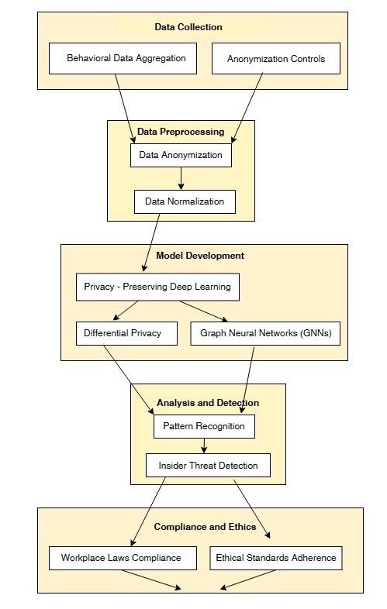
Methodology
IT21298608 | Senevirathna D.H. | 24-25J-075

Slide 41
Technologies and Tools to be used
Technologies​
TensorFlow​
PyCharm
Scikit-learn​​
Flask​
DGL (Deep Graph Library)
Tools​
Kaggle​
Python​
MLflow​
MongoDB
IT21298608 | Senevirathna D.H. | 24-25J-075

Slide 42
Study Requirement Specification
System Requirements
Hardware Requirements
High-performance servers with multi-core processors (e.g., Intel Xeon, AMD EPYC)
Minimum 64 GB RAM
High-speed network interface cards (10 Gbps or higher)
SSD storage for fast data access and processing
GPU support (e.g., NVIDIA Tesla, RTX series) for deep learning model training and inference
Network Requirements
Reliable and high-bandwidth network infrastructure
Secure network connections for data transmission
Redundant network paths for high availability and fault tolerance
Security Requirements
Secure data storage and encryption mechanisms
IT21298608 | Senevirathna D.H. | 24-25J-075

Slide 43
Study Requirement Specification Cont.
Personal Requirements
1. Skills and Expertise
Expertise in Privacy Preserving deep learning for identifying possible insider threats.
Proficiency in machine learning and deep learning techniques
Experience with data analysis tools and privacy frameworks(e.g., Differential Privacy Technique)
Knowledge of programming languages (e.g., Python)
Familiarity with data preprocessing and analysis
2. Roles and Responsibilities
Behavioral Analysts: Analyze aggregated and anonymized employee behavior data, identify patterns indicating potential insider threats, and ensure compliance with privacy standards.
Data Scientists: Develop and train deep learning models for behavior analysis, apply differential privacy techniques, and evaluate model performance.
System Administrators: Manage and maintain the infrastructure for behavior data collection and analysis, ensure data privacy, and implement security measures.
Software Developers: Develop and integrate software components for analyzing human behavior, ensure compliance with privacy regulations, and update systems as needed.
IT21298608 |Senevirathna D.H. | 24-25J-075

Slide 44
Study Requirement Specification Cont.
Software Requirements
1. Operating System
Windows operating systems
2. Development and Analysis Tools
Python with Libraries: Use Python for developing and training machine learning models, with libraries such as TensorFlow and PyTorch for deep learning, and Scikit-learn for additional machine learning functionalities.
Privacy Frameworks: Tools for implementing differential privacy and other privacy-preserving techniques.
3.Database Management
NoSQL databases (e.g., MongoDB) for storing and querying large volumes of aggregated and anonymized behavior data.
4. Monitoring and Logging
Tools like Prometheus and Grafana for real-time monitoring and visualization of system performance and model metrics.
IT21298608 | Senevirathna D.H. | 24-25J-075

Slide 45
Gantt Chart
IT21298608 | Senevirathna D.H. | 24-25J-075

Slide 46
Commercialization
Market Demand
Competitive Advantage
Scalability
Integration Capability
Subscription-Based Model
Regulatory Compliance
IT21298608 | Senevirathna D.H. | 24-25J-075

Slide 47

Budget
IT21298608 | Senevirathna D.H. | 24-25J-075

Slide 48
References
‌
[1]I. Mikulić, D. Lisjak, and N. Štefanić, “A Rule-Based System for Human Performance Evaluation: A Case Study,”: https://doi.org/10.3390/app11072904. (accessed Mar. 24, 2021).​
​
[2]“Handbook of Planning Support Science,” Google Books, 2020. https://books.google.lk/books?hl=en&lr=&id=2MvSDwAAQBAJ&oi=fnd&pg=PA37&dq=+Limited+Behavioral+data+Integration+-+human+behaviour+analysis&ots=tL7R3V5gC6&sig=ANsXCPzEf8dZ8IQYy1j8u3eNqKI&redir_esc=y#v=onepage&q=Limited%20Behavioral%20data%20Integration%20-%20human%20behaviour%20analysis&f=false (accessed Aug. 05, 2024).​
​
[3]H. Jupalle, S. Kouser, A. B. Bhatia, N. Alam, R. R. Nadikattu, and P. Whig, “Automation of human behaviors and its prediction using machine learning,” Microsystem Technologies, vol. 28, no. 8, pp. 1879–1887, doi: https://doi.org/10.1007/s00542-022-05326-4. (accessed Jun 20, 2022)​
​
[4]Maja Pantic, A. Pentland, A. Nijholt, and T. S. Huang, “Human computing and machine understanding of human behavior,” International Conference on Multimodal Interfaces, doi: https://doi.org/10.1145/1180995.1181044. (accessed Nov 02, 2006)
IT21298608 | Senevirathna D.H. | 24-25J-075

Slide 49

Organizational Threat profiling with PHYSICAL SECURITY SYSTEMS IT21058196 | K.P.A.T. Gunawardhana specialize in cybersecurity

Slide 50
Background & Research Gap
Background
Physical security systems refer to the technologies and measures implemented to protect physical assets, personnel, and information within an organization.
These include CCTV cameras, access control systems, and other surveillance equipment.
They play a crucial role in safeguarding against unauthorized access, theft, and other physical threats.
Integrating these systems with advanced analytical capabilities can enhance their effectiveness in real-time threat detection and response.
IT21226496 | Gunawardhana K.P.A.T. | 24-25J-075

Slide 51
Background & Research Gap Cont.
Research Gap
Features | CCTV Threat Detection[1] | Video Surveillance Anomaly Detection[1] | Edge Computing for Security[2] | Few-Shot Learning in Security[3] | My Approach
Real-time Threat Detection | X | X |  |  | X
Anomaly Detection |  |  | X | X | X
Scalability |  | X |  |  | X
Adaptive Learning |  |  |  | X | X
IT21058196 | Gunawardhana K.P.A.T. | 24-25J-075

Slide 52
Research Problem
Current physical security systems struggle with real-time threat detection due to the volume and complexity of video data. Developing a deep learning framework using edge processing, few-shot learning, and Temporal Convolutional Networks (TCNs) can improve real-time analysis and response. The challenge lies in integrating real-time video footage and access logs, creating robust image recognition and anomaly detection algorithms, and ensuring adaptability to dynamic security environments.
IT21058196 | Gunawardhana K.P.A.T. | 24-25J-075

Slide 53
Specific and sub objectives
Specific Objective
Develop deep learning models that integrate video data from physical security systems for threat detection.
Enhance real-time analysis capabilities to promptly identify and respond to threats.
Sub-Objectives
Implement few-shot learning for rapid model adaptation to new threats.
Utilize Temporal Convolutional Networks (TCNs) for sequential video frame analysis.
Employ edge computing to reduce latency in data processing.
IT21058196 | Gunawardhana K.P.A.T. | 24-25J-075

Slide 54
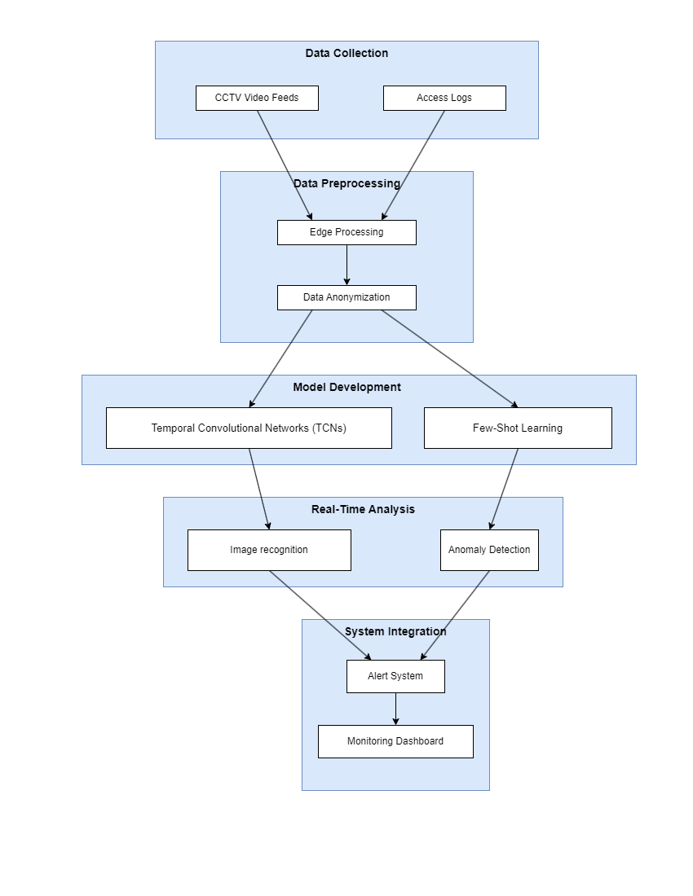
Methodology
IT21058196 | Gunawardhana K.P.A.T. | 24-25J-075

Slide 55
Technologies and Tools to be used
Technologies​
TensorFlow​
PyTorch​
Scikit-learn​
Google Colab​
Flask​
OpenCV
Tools​
Kaggle​
Python​
Keras​
MongoDB
Edge Computing Devices
IT21226496 | Gunawardhana K.P.A.T. | 24-25J-075

Slide 56
Study Requirement Specification
System Requirements
Hardware Requirements
High-performance servers with multi-core processors (e.g., Intel Xeon, AMD EPYC)
Minimum 64 GB RAM
High-speed network interface cards (10 Gbps or higher)
SSD storage for fast data access and processing
GPU support (e.g., NVIDIA Tesla, RTX series) for deep learning model training and inference
Network Requirements
Reliable and high-bandwidth network infrastructure
Secure network connections for data transmission
Security Requirements
Secure data storage and encryption mechanisms
IT21058196 | Gunawardhana K.P.A.T. | 24-25J-075

Slide 57
Study Requirement Specification Cont.
Personal Requirements
1. Skills and Expertise
Expertise in Video Surveillance and Physical Security Systems
Proficiency in machine learning and deep learning techniques
Experience with Video Analysis Tools (e.g., OpenCV and FFmpeg )
Knowledge of programming languages (e.g., Python)
Familiarity with data preprocessing and analysis
IT21226496 | Gunawardhana K.P.A.T. | 24-25J-075

Slide 58
Study Requirement Specification Cont.
Software Requirements
1. Operating System
Windows operating systems
2. Development and Analysis Tools
Python with Libraries: Utilize Python for developing and training machine learning models, with libraries such as TensorFlow, and PyTorch.
Video Analysis Tools: Tools like OpenCV and FFmpeg for video data preprocessing and real-time analysis.
3.Database Management
NoSQL databases (e.g., MongoDB) for storing and querying large volumes of video data and metadata.
4. Monitoring and Logging
Tools like Prometheus and Grafana for real-time monitoring and visualization
IT21226496 | Gunawardhana K.P.A.T. | 24-25J-075

Slide 59
Gantt Chart
IT21058196 | Gunawardhana K.P.A.T. | 24-25J-075

Slide 60
Commercialization
Market Demand
Competitive Advantage
Scalability
Integration Capability
Subscription-Based Model
Regulatory Compliance
IT21058196 | Gunawardhana K.P.A.T. | 24-25J-075

Slide 61
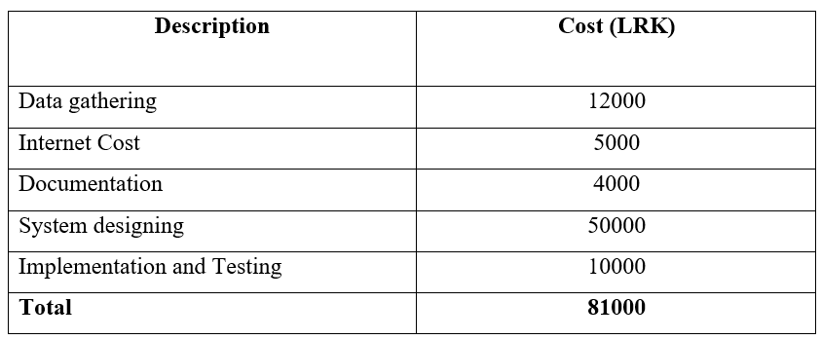
Budget
IT21058196 | Gunawardhana K.P.A.T. | 24-25J-075

Slide 62
References
[1] H.-T. Duong, V.-T. Le, and V. T. Hoang, “Deep Learning-Based Anomaly Detection in Video Surveillance: A Survey,” Sensors, vol. 23, no. 11, p. 5024, Jan. 2023, doi: https://doi.org/10.3390/s23115024.
[2] Frank, L. (2024). "Edge AI: Deploying models directly on edge devices for real-time processing." Artificial Intelligence, April 2024.
[3] Ravi, V., et al. (2021). "Deep Learning for Cyber Security Applications: A Comprehensive Survey." TechRxiv.
IT21058196 | Gunawardhana K.P.A.T. | 24-25J-075

